Slide 1
5- Short-circuit Evaluation

Slide 2
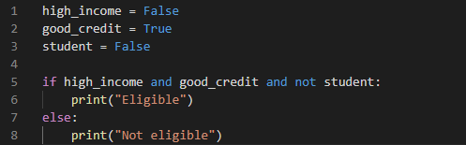

Slide 3
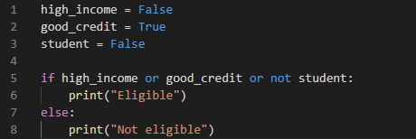
So in python, logical operators are short circuit.

